Slide 1
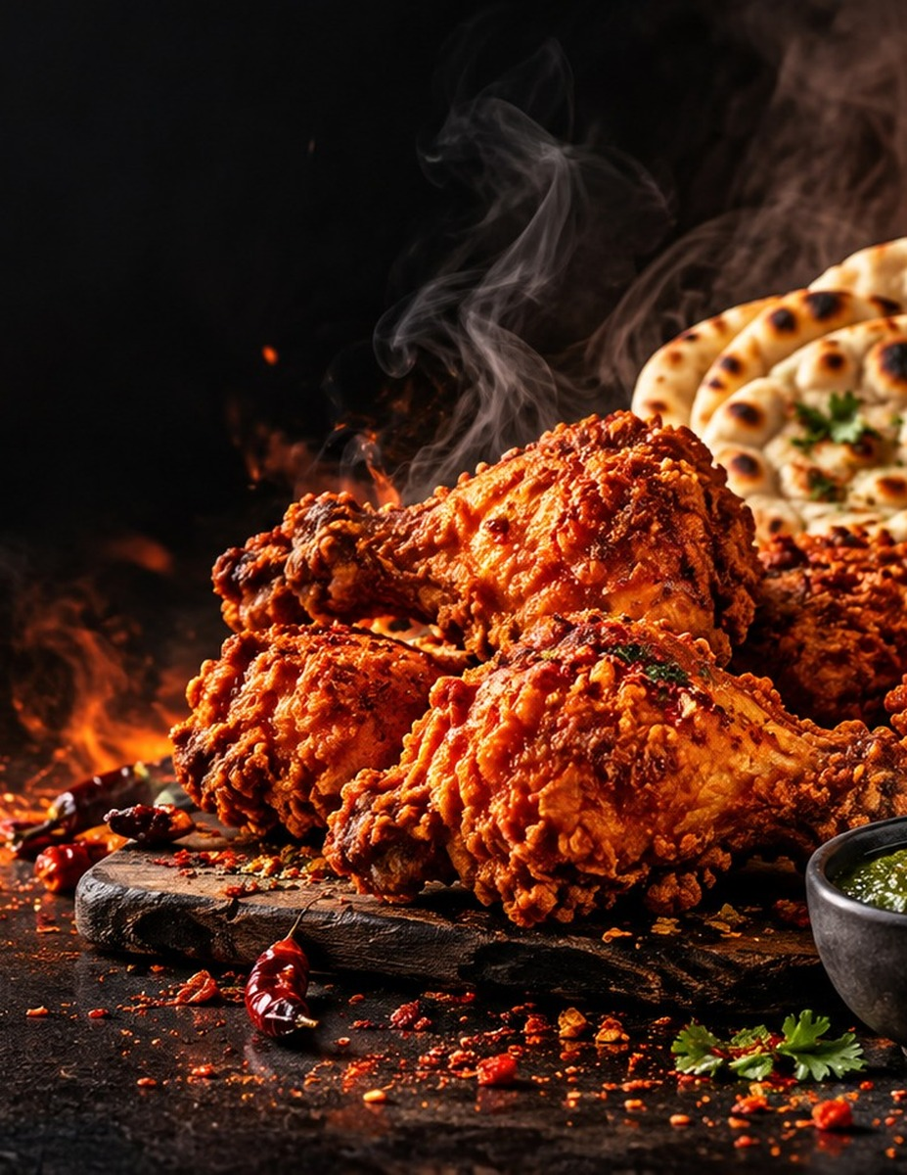

HALAL DESI + FAST FOOD
MENU
Crispy chicken • Spicy burgers • Biryani • Karahi • BBQ platters
Order Online | Pickup | Delivery
Replace phone, address, QR code, and prices in Canva after import.

Slide 2
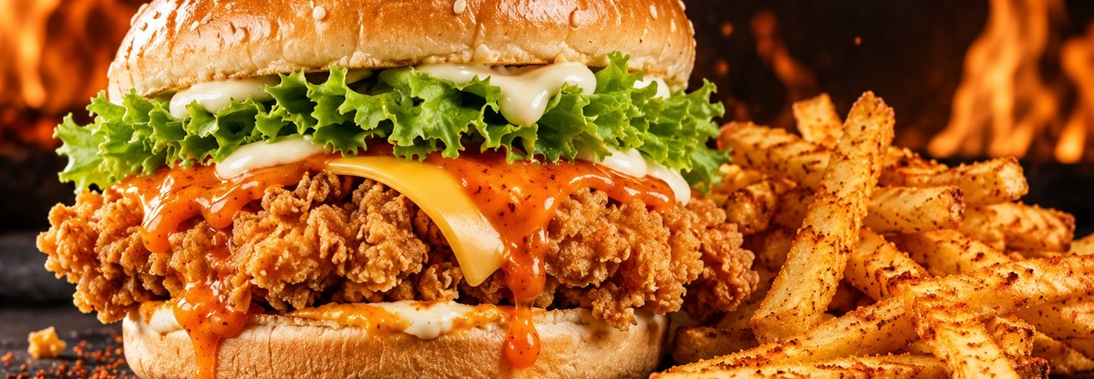
100% HALAL
Crispy halal fast food made fresh with signature sauces.
BURGERS & WRAPS
Spicy Chicken Burger
£6.99
Crispy chicken fillet, lettuce, cheese, mayo, and Eman’s spicy sauce.
Classic Chicken Burger
£5.99
Crispy chicken, lettuce, mayo, and soft toasted bun.
Double Beef Burger
£7.99
Two halal beef patties, cheese, caramelized onion, lettuce, and house sauce.
Chicken Wrap
£5.99
Grilled spiced chicken, lettuce, onion, garlic mayo, and chili sauce.
Paratha Roll
£5.49
Spiced chicken wrapped in paratha with onion, chutney, and mayo.
Loaded Fries
£4.99
Fries topped with chicken, cheese sauce, jalapeños, and spicy mayo.
All items are halal. Ask staff for spice level: mild, medium, hot, or extra hot.

Slide 3
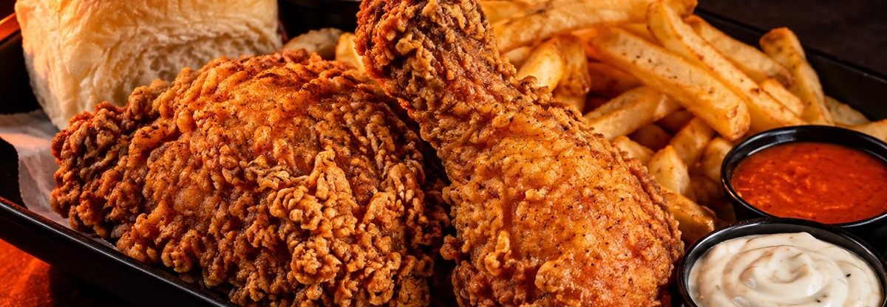
100% HALAL
Golden, crunchy, spicy chicken for every craving.
FRIED CHICKEN
2 Piece Chicken Meal
£6.49
2 crispy chicken pieces, fries, dip, and drink.
3 Piece Chicken Meal
£7.99
3 crispy chicken pieces, fries, dip, and drink.
Hot Wings Meal
£6.99
6 spicy wings, fries, dip, and drink.
Chicken Nuggets Meal
£5.99
8 golden nuggets, fries, dip, and drink.
Family Bucket
£24.99
10 chicken pieces, 8 wings, 2 fries, dips, and 1.5L drink.
Sauces
£0.50
Garlic mayo, spicy Eman’s sauce, mint chutney, BBQ, ketchup.
Perfect for takeaway, delivery, and family sharing.

Slide 4
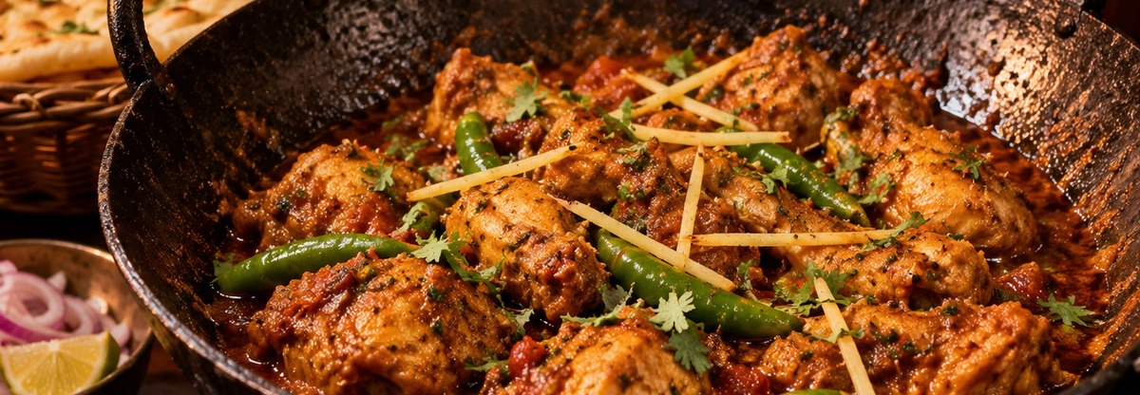
100% HALAL
Bold South Asian comfort food with a spicy halal twist.
DESI FAVOURITES
Chicken Karahi
£9.99
Rich tomato masala with green chilies, ginger, coriander, and naan.
Chicken Biryani
£7.99
Aromatic rice with masala chicken, raita, and fresh salad.
Chicken Tikka
£8.49
Flame-grilled tikka with naan, salad, and mint chutney.
Seekh Kebab
£7.99
Spiced minced meat kebabs served with naan and chutney.
BBQ Platter
£14.99
Tikka, seekh kebab, creamy boti, fries, naan, salad, and sauces.
Extra Naan / Raita / Salad
£1.50
Fresh sides to complete your desi meal.
Desi menu items can be served mild, medium, or hot.

Slide 5
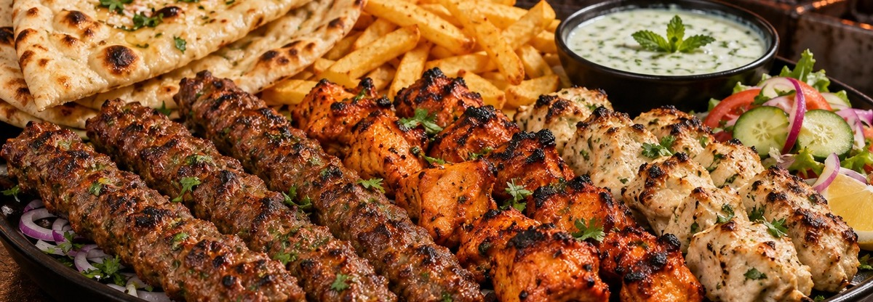
100% HALAL
Big halal sharing plates for friends and family.
PLATTERS & DEALS
BBQ Mixed Platter
£14.99
Seekh kebab, tikka, creamy boti, naan, fries, salad, and dips.
Burger Duo
£15.99
2 chicken burgers, 2 fries, 2 drinks, and 2 dips.
Wing Box
£13.99
12 hot wings, 2 fries, 2 dips, and 2 drinks.
Family Feast
£29.99
Bucket chicken, burgers, wings, fries, nuggets, dips, and drink.
Desi Feast
£27.99
Karahi, biryani, kebabs, naan, raita, salad, and chutney.
Kids Meal
£4.99
Nuggets or mini burger with fries, drink, and dip.
Great for office lunches, game nights, and weekend family meals.

Slide 6
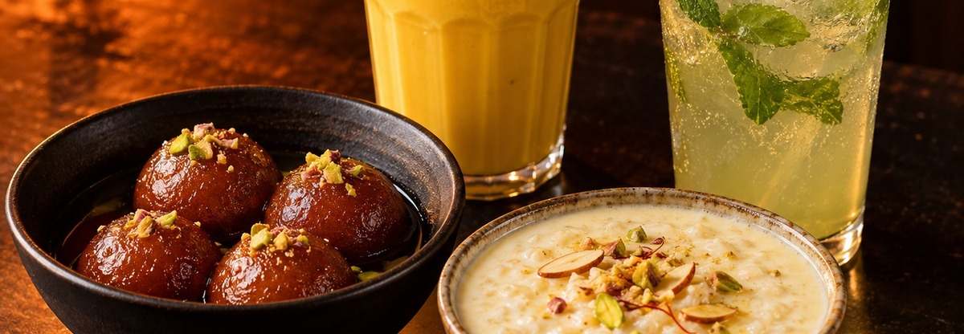
100% HALAL
Cool drinks and sweet endings after the heat.
DRINKS & DESSERTS
Soft Drinks
£1.49
Cola, lemon-lime, orange, or diet options.
Mint Lemonade
£2.49
Chilled lemon drink with mint and ice.
Mango Lassi
£3.49
Creamy mango yogurt drink with nuts.
Water
£1.00
Still bottled water.
Gulab Jamun
£3.49
Warm syrup-soaked dessert balls with pistachio.
Kheer
£3.49
Creamy rice pudding with nuts and saffron.
Please update prices and availability before publishing.

